Slide 1
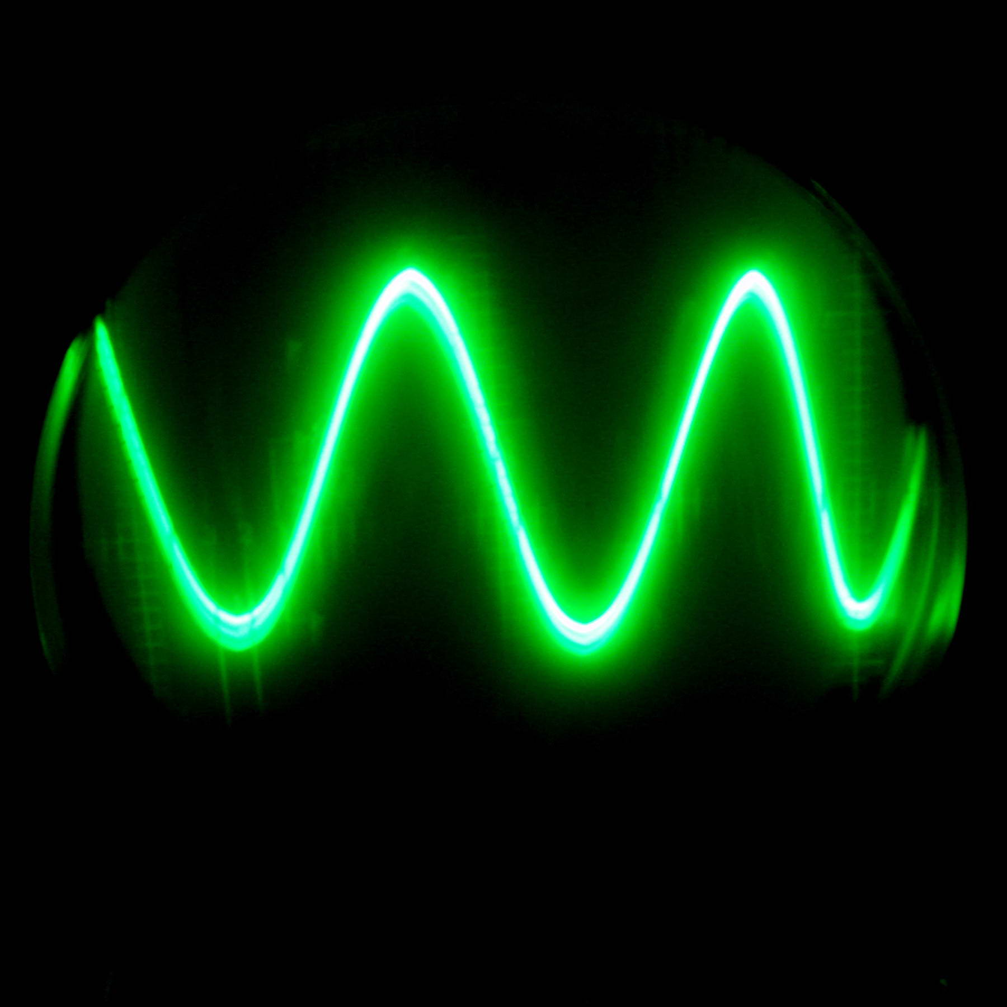
Power in AC Circuits

Slide 2
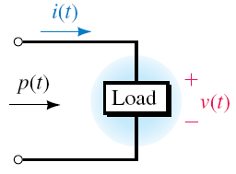
Instantaneous Power
Instantaneous power absorbed by the network is, p =v(t).i(t)
Let v(t) = V_{m} cos (ωt + θ_{v}) and i(t) = I_{m}cos(ωt + θ_{i})
Which can be written as
v(t) = V_{m} cos (ωt + θ_{v} − θ_{i}) and i(t) = I_{m}cos(ωt)

Slide 3
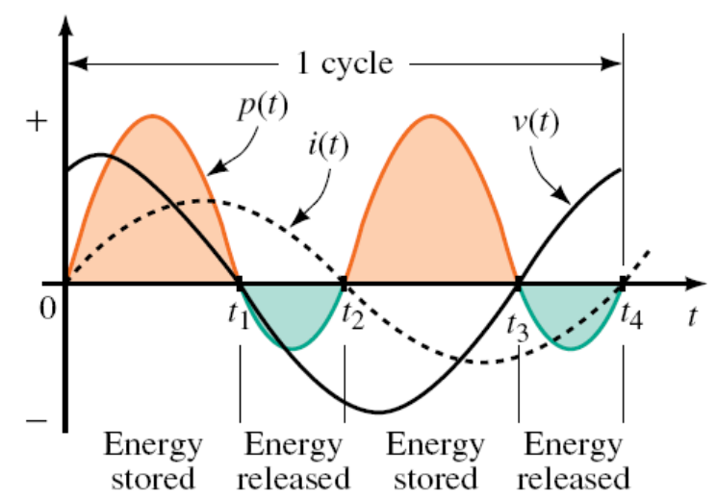
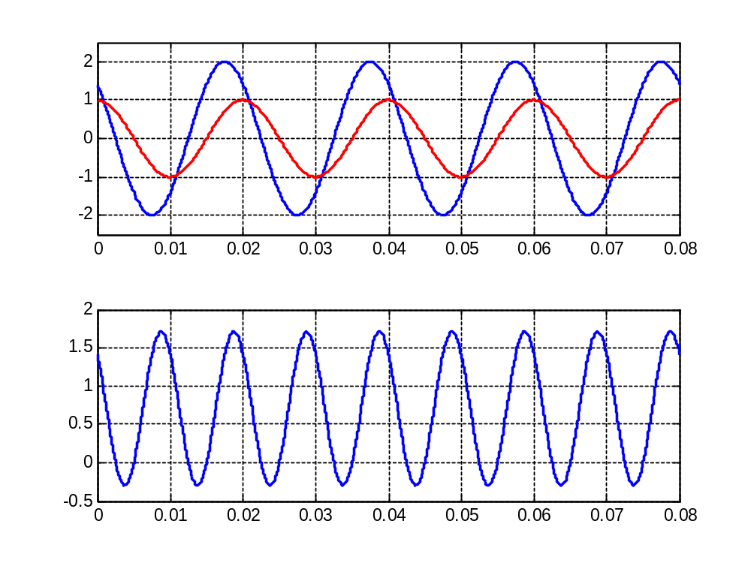
v(t) = V_{m} cos (ωt + θ_{v} − θ_{i}) and i(t) = I_{m}cos(ωt)
p = V_{m} cos(ωt + θ_{v} – θ_{i} ) . I_{m} cos(ωt)
Example when θ_{v} − θ_{i} = 45º
45º
v
i
Instantaneous Power (p)
positive p = power transferred from source to network
negative p = power transferred from network to source

Slide 4
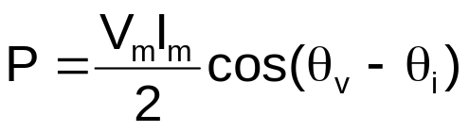
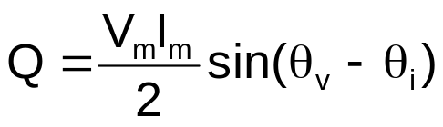
v(t) = V_{m} cos (ωt + θ_{v} − θ_{i}) and i(t) = I_{m}cos(ωt)
p = V_{m} cos(ωt + θ_{v} – θ_{i} ) . I_{m} cos(ωt)
Using trigonometry functions, it can be shown that:
p =
Which can be written as
p = P + Pcos(2ωt) − Qsin(2ωt)
= AVERAGE POWER (watt)
= REACTIVE POWER (var)

Slide 5
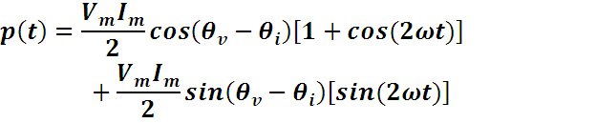
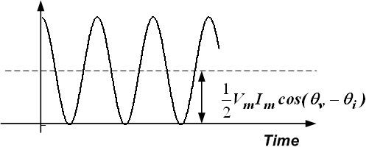
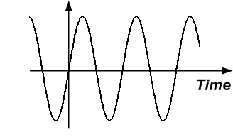
Alternate representation for p(t)
Which can be decomposed into two plots:
  Average (real) power and reactive power

Slide 6
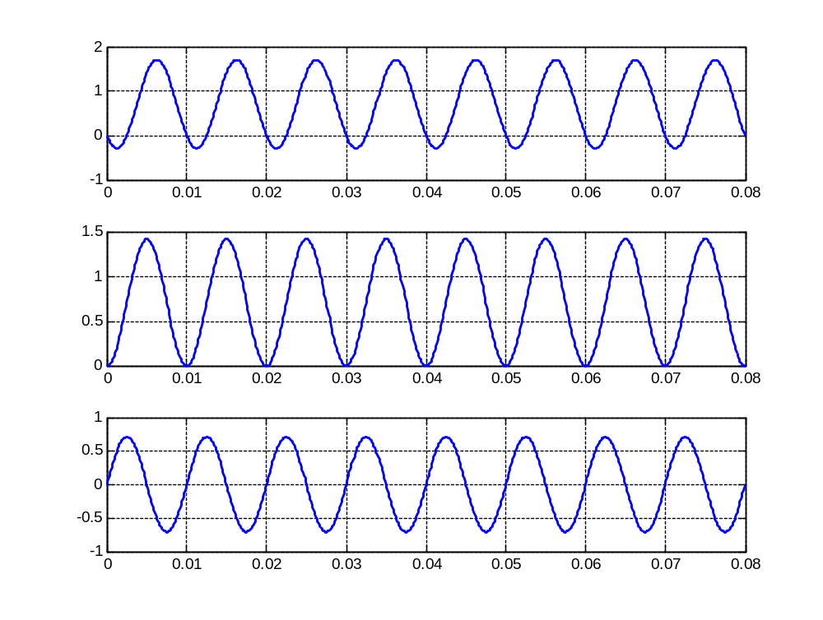
p =
Example for
θ_{v}-θ_{i} = 45º

Slide 7
p =
p = P + P cos(2ωt) − Q sin(2ωt)
P = average power
Q = reactive power

Slide 8


Average Power
We are generally more interested in the average power delivered to a load:
For sinusoidal voltage and current:
  This is also called the real power (it’s the power that’s provided to the resistive part of the load over time)
  Units are watts

Slide 9
p = P + P cos(2ωt) − Q sin(2ωt)
P = AVERAGE POWER
Useful power – also known as ACTIVE POWER
Converted to other useful form of energy – heat, light, sound, etc
Q = REACTIVE POWER
Power that is being transferred back and forth between load and source
Associated with L or C – energy storage element – no losses
Inductive load: Q positive, Capacitive load: Q negative

Slide 10
RMS values
We want to assess the power delivered by different types of time-varying signals
Find a DC (constant) value which delivers the same average power as the time-varying signal
  Called the effective or RMS value of the signal
  Used to “compare” different time-varying signals

Slide 11
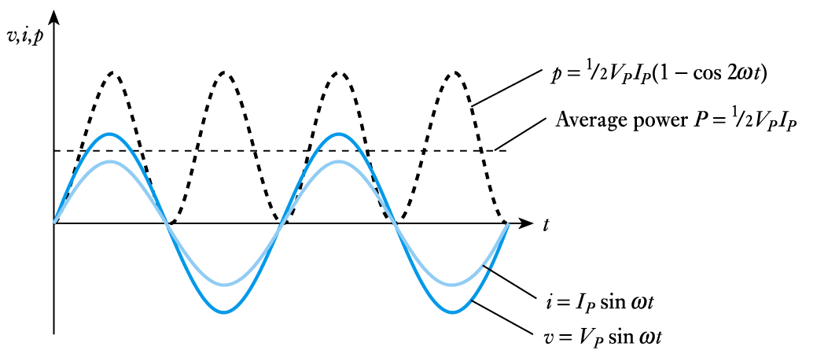
Power in Resistive Components
Relationship between v, i and p in a resistor

Slide 12




RMS values – continued
Average power:
Effective DC value:
Equating to time-average value:
,

Slide 13



Definition of RMS values
The effective (or RMS) value of a signal is equal to the DC value which provides the same average power to a resistor
For sinusoidal signal with no DC offset:
,
Average power in terms of RMS values:

Slide 14

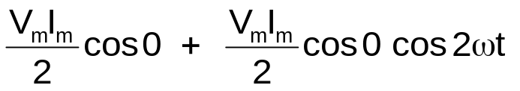
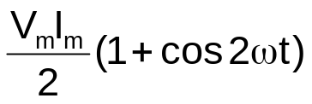
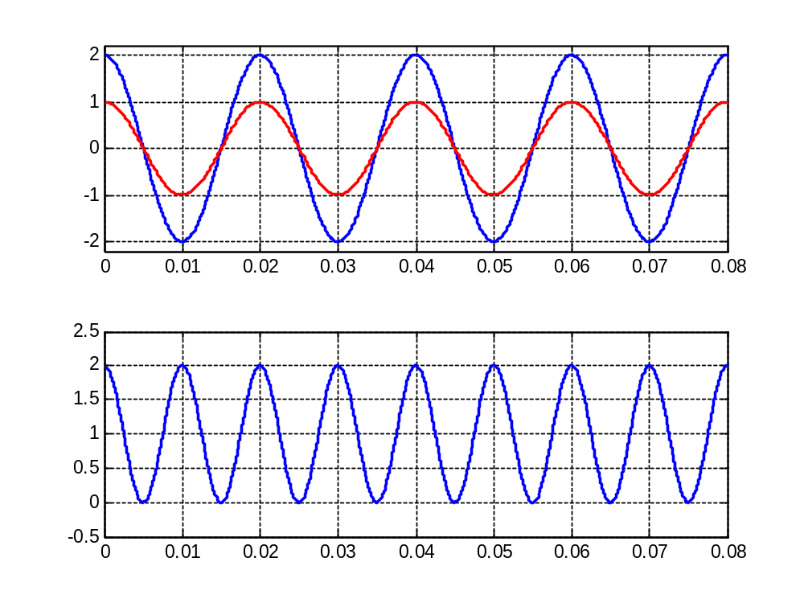
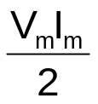
Power for a resistor
Voltage and current are in phase,
p =
p =
p =
P = average power =
Q = reactive power = 0

Slide 15
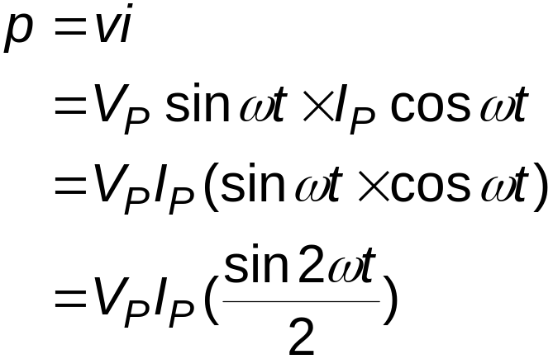
Power in Capacitors
From our discussion of capacitors we know that the current leads the voltage by 90°. Therefore, if a voltage v = V_{p} sin ωt is applied across a capacitance C, the current will be given by
i = I_{p} cos ωt
Then
The average power is zero

Slide 16
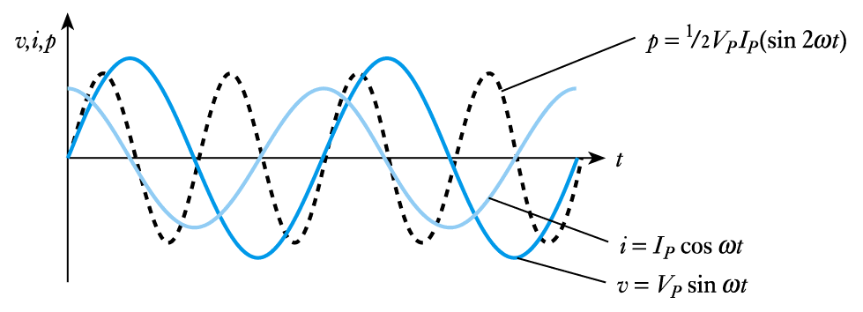
Power in Capacitors
Relationship between v, i and p in a capacitor

Slide 17
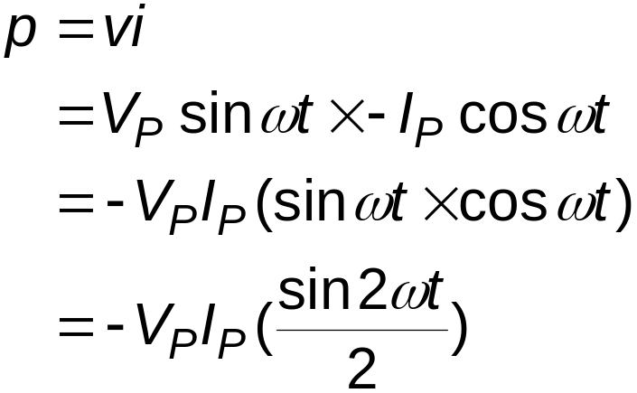
Power in Inductors
From our discussion of inductors we know that the current lags the voltage by 90°. Therefore, if a voltage v = V_{p} sin ωt is applied across an inductance L, the current will be given by i = -I_{p} cos ωt
Therefore
Again the average power is zero

Slide 18
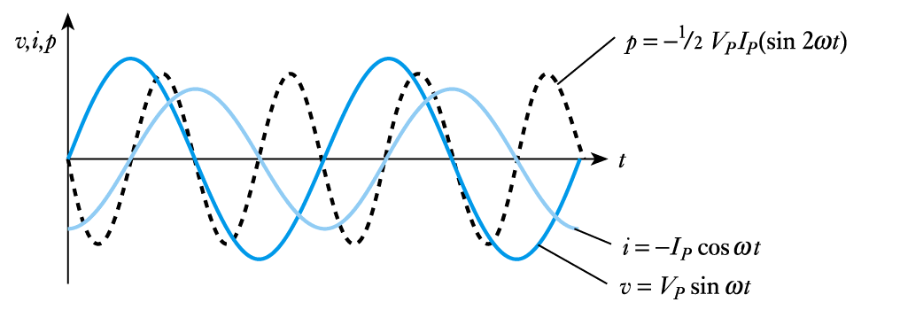
Power in Inductors
Relationship between v, i and p in an inductor

Slide 19
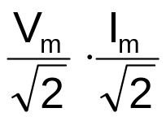


Apparent Power and Power Factor
Consider v(t) = V_{m} cos (ωt + θ_{v}) and i(t) = I_{m}cos(ωt + θ_{i})
We have seen,
=
Is known as the APPARENT POWER
VA
(units = volt-amps = VA)

Slide 20


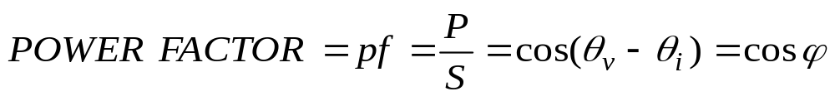
Apparent Power and Power Factor
We can now write,
The term
is known as the POWER FACTOR
For inductive load, φ is positive → current lags voltage → lagging pf
For capacitive load, φ is negative → current leads voltage → leading pf

Slide 21
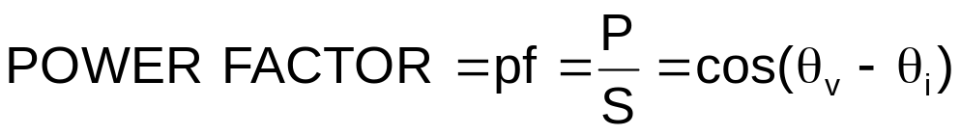
Apparent Power and Power Factor
I_{rms} = 5∠- 40º
+
V_{L}
−
V_{rms} = 250∠10º
+
−
Load
Source
Power factor of the load = cos (10-(-40)) = cos (50º) = 0.6428
(lagging)
Apparent power, S = 1250 VA
Active power absorbed by the load is 250(5) cos (50º)= 1250(0.6428) = 803.5 watt
Reactive power absorbed by load is 250(5) sin (50º)= 1250(0.6428) = 957.56 var

Slide 22
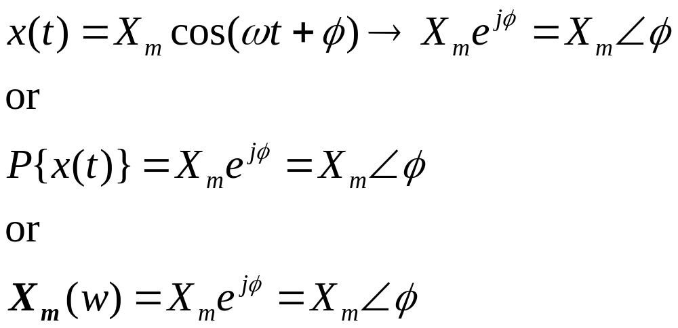
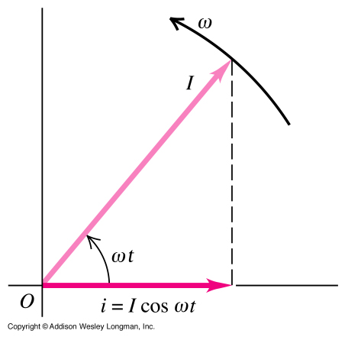
Definition of a Phasor
A phasor is a complex number. In particular, a phasor is a complex number whose magnitude is the magnitude of a corresponding sinusoid, and whose phase is the phase of that corresponding sinusoid. There are a variety of notations for this process.

Slide 23
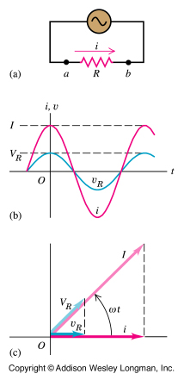
Graphs (and phasors) of instantaneous voltage and current for a resistor.
Notation:
-lower case letters are time dependent and
-upper case letters are constant.
For example,
i(t) is the time dependent current and
I is current amplitude;
V_{R} is the voltage amplitude (= IR ).
i(t) = I cos ωt (source)
v_{R}(t) = i(t) R
v_{R}(t) = IR cos ωt
where V_{R} = IR is
the voltage amplitude.
V_{R} = IR

Slide 24
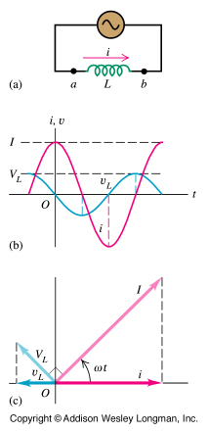
Graphs (and phasors) of instantaneous voltage and current for an inductor.
i(t) = I cos ωt (source)
v_{L}(t) = L di / dt
v_{L}(t) = L d(I cos ωt )/dt v_{L}(t) = -IωL sin ωt
v_{L}(t) = +IωL cos (ωt + 90⁰)
V_{L} = jIωL (= jIX_{L})
φ = +90⁰ is the
PHASE ANGLE
(angle between voltage across and current through the inductor).
X_{L} = ωL
Notes:
-sin A = cos(A+90)

Slide 25
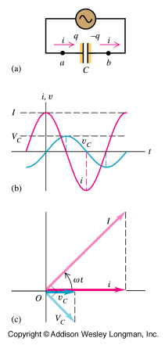
Graphs (and phasors) of instantaneous voltage and current for a capacitor.
i(t) = I cos ωt (source)
i(t) = dq / dt = I cos ωt Integrating we get
q(t) = (I/ω) sin ωt
and from q = C v_{C} we get
v_{C}(t) = (I/ωC) sin ωt
v_{C}(t)=(I/ωC) cos (ωt - 90⁰)
V_{C} = I/jωC (= -jIX_{C})
φ = -90⁰ is the
PHASE ANGLE
(angle between voltage across and current through the inductor).
X_{C} = 1/ωC
Notes:
sin A = +cos (A-90)

Slide 26
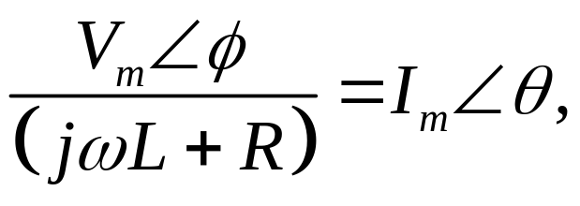
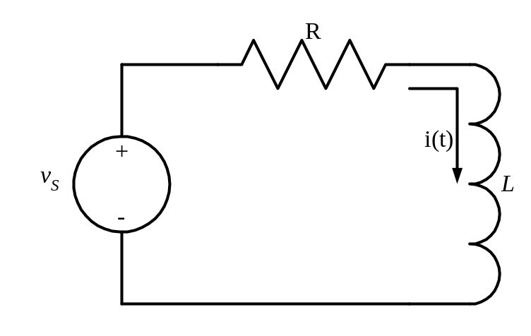
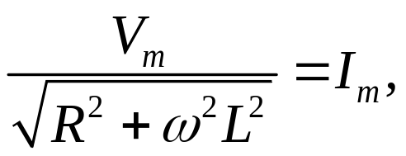
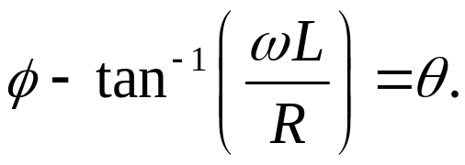
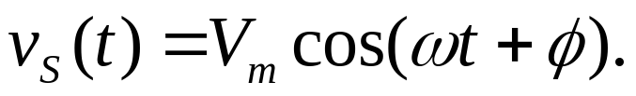
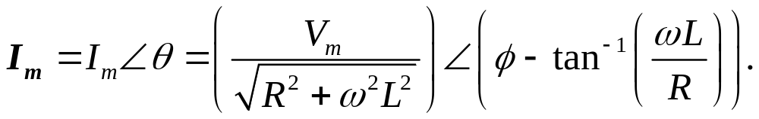
The Phasor Solution
Let’s compare the solution we got for this same circuit in the first part of this module. Using this solution,
Imagine the circuit here has a sinusoidal source. What is the steady state value for the current i(t)?
let’s take the magnitude of each side. We get
and then take the phase of each side. We get
We get
Notes:
{We need a link here to DPKC_Mod08_Part01, Slide 30.

Slide 27
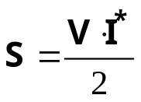



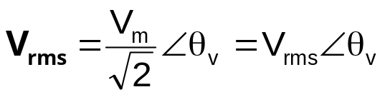
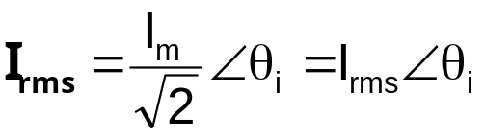

Complex Power
Defined as:
(VA)
Where,
and
⇒
If we let
and
(VA)

Slide 28
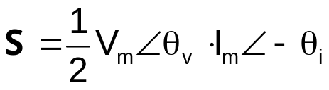
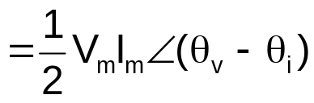




Complex Power
(VA)
Where,

Slide 29
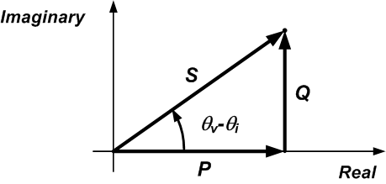
Power Triangle

Slide 30
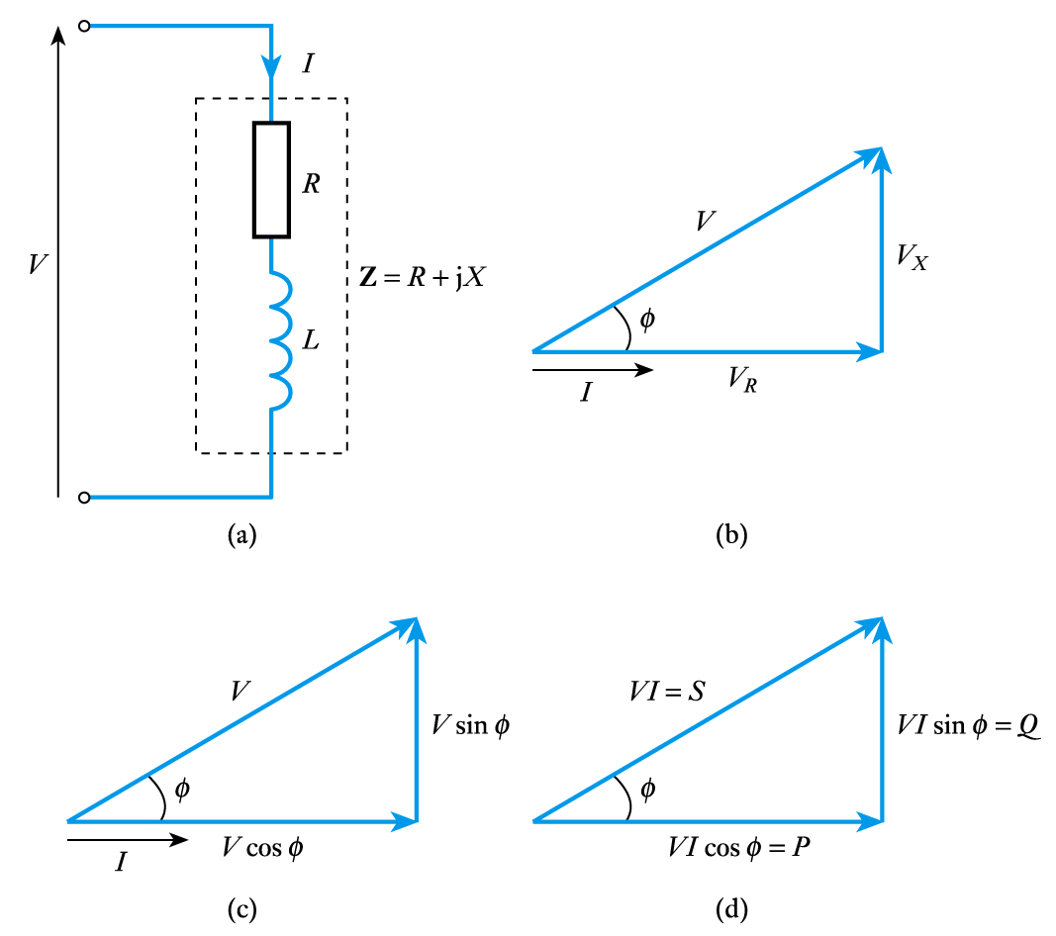
Power Triangle
Consider an
RL circuit
  the relationship
  between the various
  forms of power can
  be illustrated using
  a power triangle

Slide 31
Power Triangle
Therefore
Active Power P = VI cos φ watts
Reactive Power Q = VI sin φ var
Apparent Power S = VI VA
S² = P² + Q²

Slide 32

Complex Power
The complex power contains all information about the load
I_{rms} = 5∠- 40º
We have seen before:
Apparent power, S = 1250 VA
+
V_{L}
−
V_{rms} = 250∠10º
Active power, P = 803.5 watt
+
−
Load
Source
Reactive power, Q = 957.56 var
With complex power,
S = 250∠10º (5∠+40º) VA
S = 1250 ∠50º VA
S
S = (803.5 + j957.56) VA
957.56 var
|S| = S = Apparent power
50º
= 1250 VA
803.5 watt

Slide 33


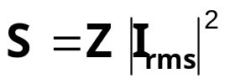
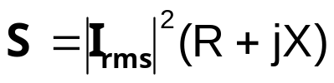
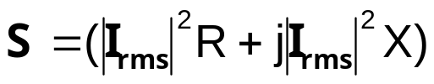
Complex Power
Other useful forms of complex power
We know that
P
Q

Slide 34
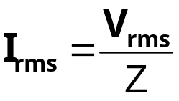
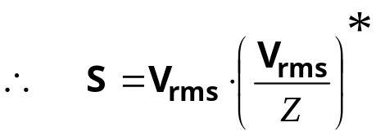
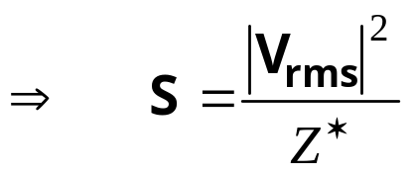
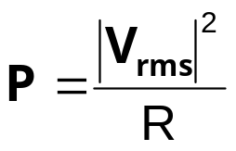
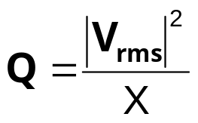
Complex Power
Other useful forms of complex power
We know that
For a pure resistive element,
For a pure reactive element,

Slide 35
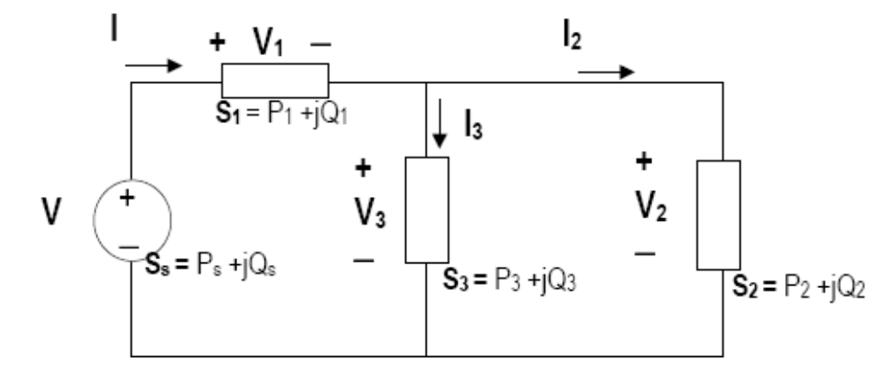


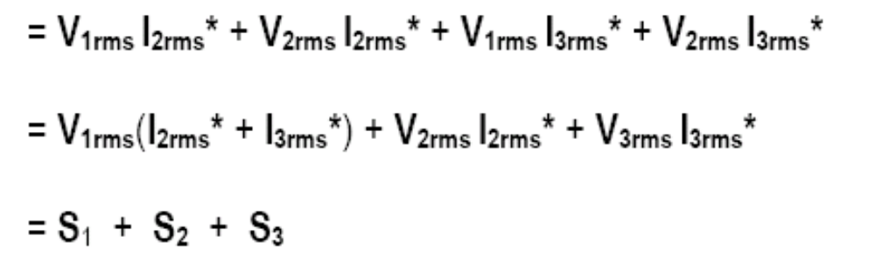
Conservation of AC Power
Complex, real, and reactive powers of the sources equal the respective sums of the complex, real and reactive powers of the individual loads

Slide 36

Conservation of AC Power
Complex, real, and reactive powers of the sources equal the respective sums of the complex, real and reactive powers of the individual loads
S_{s} = P_{s} +jQ_{s} = (P₁ + P₂ + P₃) + j (Q₁ + Q₂ + Q₃)
But

Slide 37
Maximum Average Power Transfer
Max power transfer in DC circuit can be applied to AC circuit analysis
Z_{Th}
I
+
V
−
V_{Th}
AC linear circuit
+
−
Z_{L}
What is the value of Z_{L} so that maximum average power is transferred to it?

Slide 38
Maximum Average Power Transfer
Z_{Th}
I
+
V
−
V_{Th}
+
−
Z_{L}
What is the value of Z_{L} so that maximum average power is transferred to it?

Slide 39



Maximum Average Power Transfer
What is the value of Z_{L} so that maximum average power is transferred to it?
Z_{Th}
I
+
V
−
Z_{Th}= R_{Th} + jX_{Th}
V_{Th}
+
−
Z_{L}
Z_{L}= R_{L} + jX_{L}
P max when
and

Slide 40


Maximum Average Power Transfer
What is the value of Z_{L} so that maximum average power is transferred to it?
Z_{Th}
I
+
V
−
V_{Th}
+
−
Z_{L}
P max when
and
X_{L} = −X_{Th} , R_{L}= R_{Th}

Slide 41
Three-Phase Systems
Almost all electric power generation and most of the power transmission in the world is in the form of three-phase AC circuits. A three-phase AC system consists of three-phase generators, transmission lines, and loads.
There are two major advantages of three-phase systems over a single-phase system:
More power per kilogram of metal form a three-phase machine;
Power delivered to a three-phase load is constant at all time, instead of pulsing as it does in a single-phase system.
The first three-phase electrical system was patented in 1882 by John Hopkinson - British physicist, electrical engineer, Fellow of the Royal Society.

Slide 42



1. Generation of three-phase voltages and currents
Each of three-phase generators can be connected to one of three identical loads.
This way the system would consist of three single-phase circuits differing in phase angle by 120⁰.
The current flowing to each load can be found as

Slide 43


1. Generation of three-phase voltages and currents
Therefore, the currents flowing in each phase are

Slide 44

1. Generation of three-phase voltages and currents
We can connect the negative (ground) ends of the three single-phase generators and loads together, so they share the common return line (neutral).

Slide 45


1. Generation of three-phase voltages and currents
The current flowing through a neutral can be found as
Which is:

Slide 46

Voltages and currents
There are two types of connections in three-phase circuits: Y and Δ.
Each generator and each load can be either Y- or Δ-connected. Any number of Y- and Δ-connected elements may be mixed in a power system.
Phase quantities - voltages and currents in a given phase.
Line quantities – voltages between the lines and currents in the lines connected to the generators.

Slide 47


Voltages and currents
1. Y-connection (cont 2)
Y connection
The current in any line is the same as the current in the corresponding phase.
Voltages are:

Slide 48


Voltages and currents
Y connection
Magnitudes of the line-to-line voltages and the line-to-neutral voltages are related as:
In addition, the line voltages are shifted by 30⁰ with respect to the phase voltages.
In a connection with abc sequence, the voltage of a line leads the phase voltage.

Slide 49



Voltages and currents
1. Δ-connection
Δ connection
assuming a resistive load:

Slide 50



Voltages and currents
1. Δ-connection (cont)
Δ connection
The currents are:
The magnitudes:

Slide 51

Voltages and currents
For the connections with the abc phase sequences, the current of a line lags the corresponding phase current by 30⁰ (see Figure below).
For the connections with the acb phase sequences, the line current leads the corresponding phase current by 30⁰.

Slide 52



Power relationships
For a balanced Y-connected load with the impedance Z_{φ} = Z∠θ⁰:
and voltages:
The currents can be found:

Slide 53



Power relationships
Y connection
The instantaneous power is:
Therefore, the instantaneous power supplied to each phase is:
Since

Slide 54

Power relationships
Y connection
Therefore
The total power on the load
The pulsing components cancel each other because of 120⁰ phase shifts.

Slide 55

Power relationships
The instantaneous power in phases.
The total power supplied to the load is constant.

Slide 56



Power relationships
Y connection
Phase quantities in each phase of a Y- or Δ-connection.
Real
Reactive
Apparent
Note: these equations are valid for balanced loads only.

Slide 57




Power relationships
Y connection
Line quantities: Y-connection.
Power consumed by a load:
Since for this load
Therefore:
Finally:
Note: these equations are valid for balanced loads only.

Slide 58


Power relationships
Line quantities: Δ-connection.
Δ connection
Power consumed by a load:
Since for this load
Therefore:
Finally:
Same as for a Y-connected load!
Note: these equations were derived for a balanced load.

Slide 59


Power relationships
Line quantities: Y- and Δ-connection.
Y or Δ connection
Reactive power
Apparent power
Note: θ is the angle between the phase voltage and the phase current – the impedance angle.

Slide 60
Power Measurement
In three-phase systems we need to sum the power taken from the various phases
  In balanced systems (systems that take equal power from each phase) a single wattmeter can be used, its reading being multiplied by 3 to get the total power
  In a four-wire system it may be necessary to use 3 wattmeter
  In three-wire arrangements we can deduce the total power from measurements using 2 wattmeter

Slide 61


